Slide 1
SR – Detection
Muhsin Fatih, Kshitiz Malhotra
Notes:
MUHSIN

Slide 2
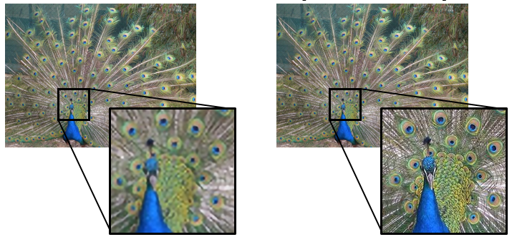
Image Super-Resolution (SR)
Low resolution Image patch
High resolution Image patch
Applications
Satellite Imaging
Media Content
Surveillance
Face Recognition
Medical Imaging
...
Upscale
Notes:
MUHSIN

Slide 3
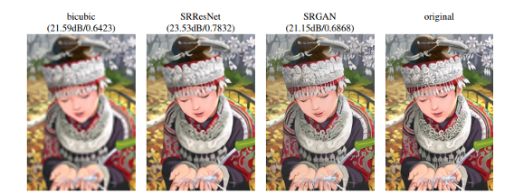
Different SR Approaches
Interpolation Based Methods
Nearest Neighbor
Bilinear
Bicubic
Other
Learning Based Methods
LapSRN
SRCNN
SResNet
SR-GAN
Notes:
MUHSIN

Slide 4
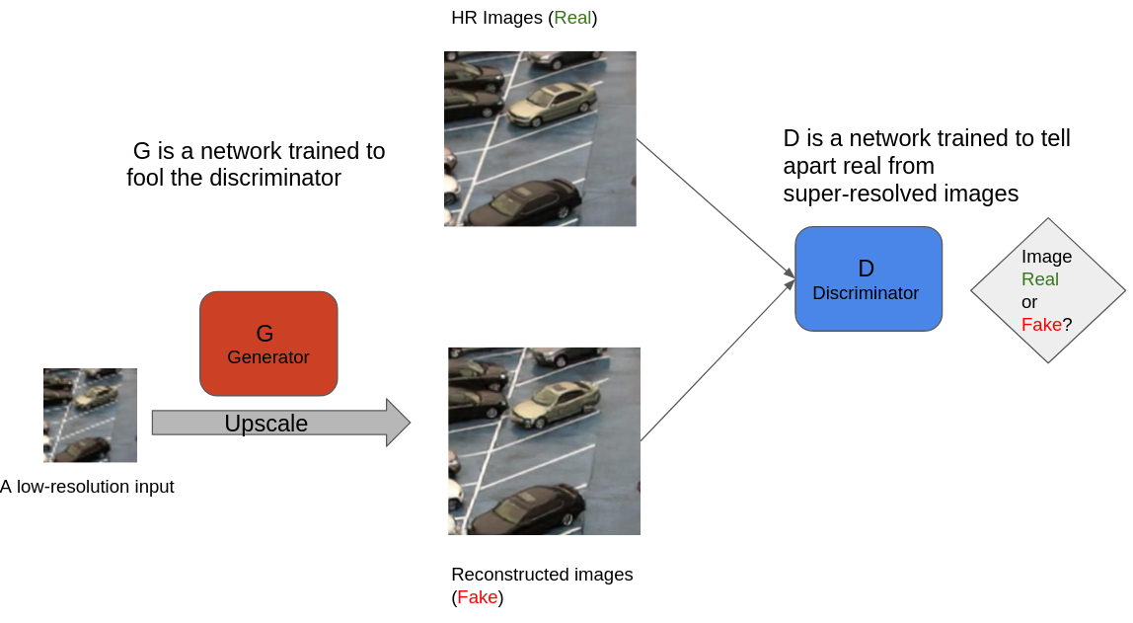
Generative Adveserial Network
Notes:
MUHSIN

Slide 5
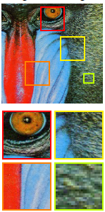
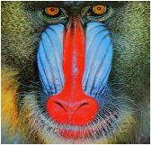
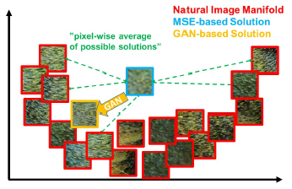
Losses
MSE loss in Feature Space
Adveserial Loss
Notes:
KSHITIZ

Slide 6
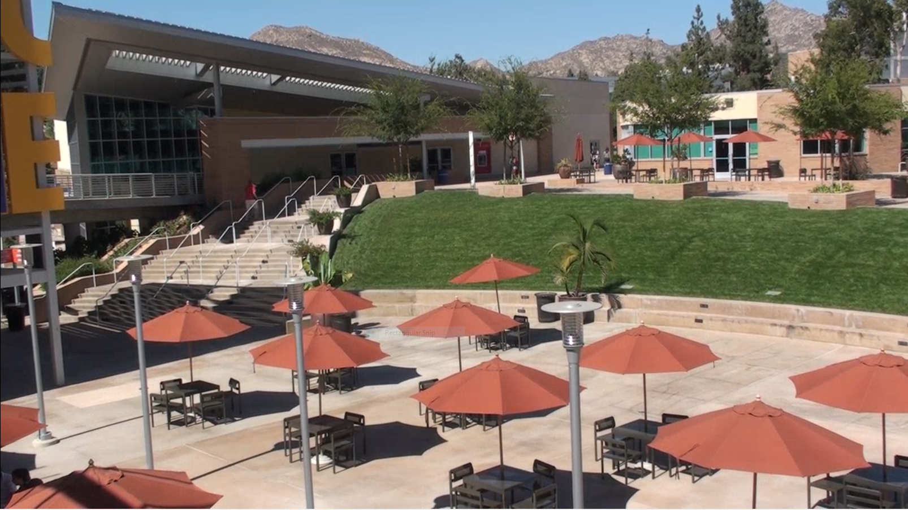
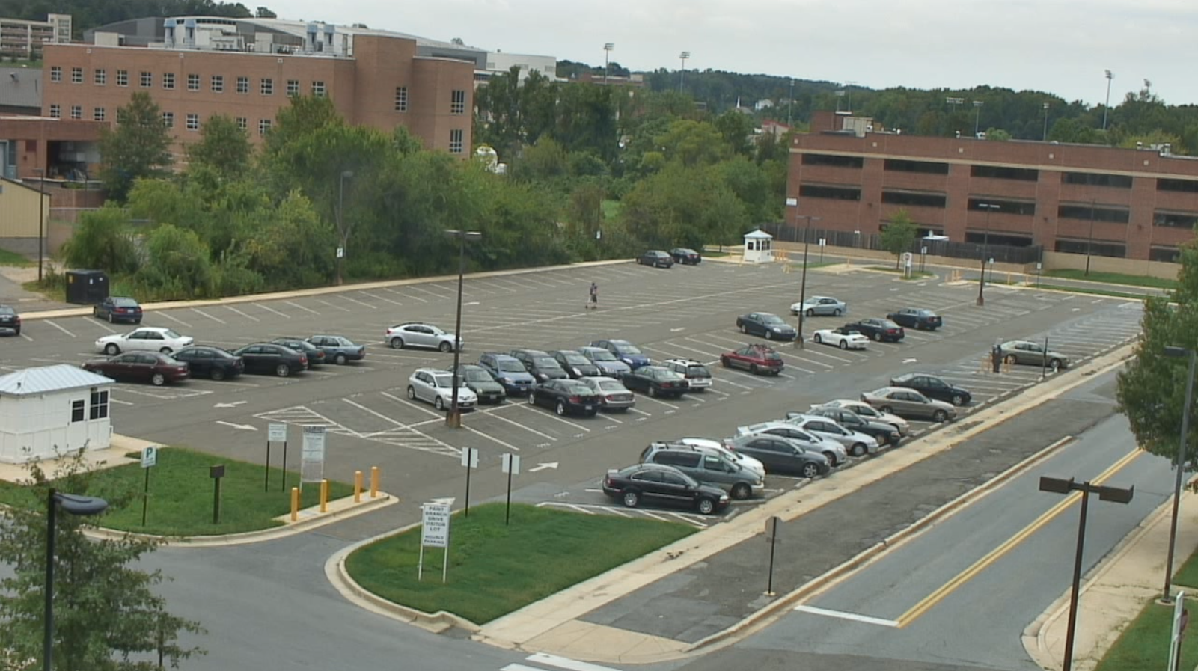
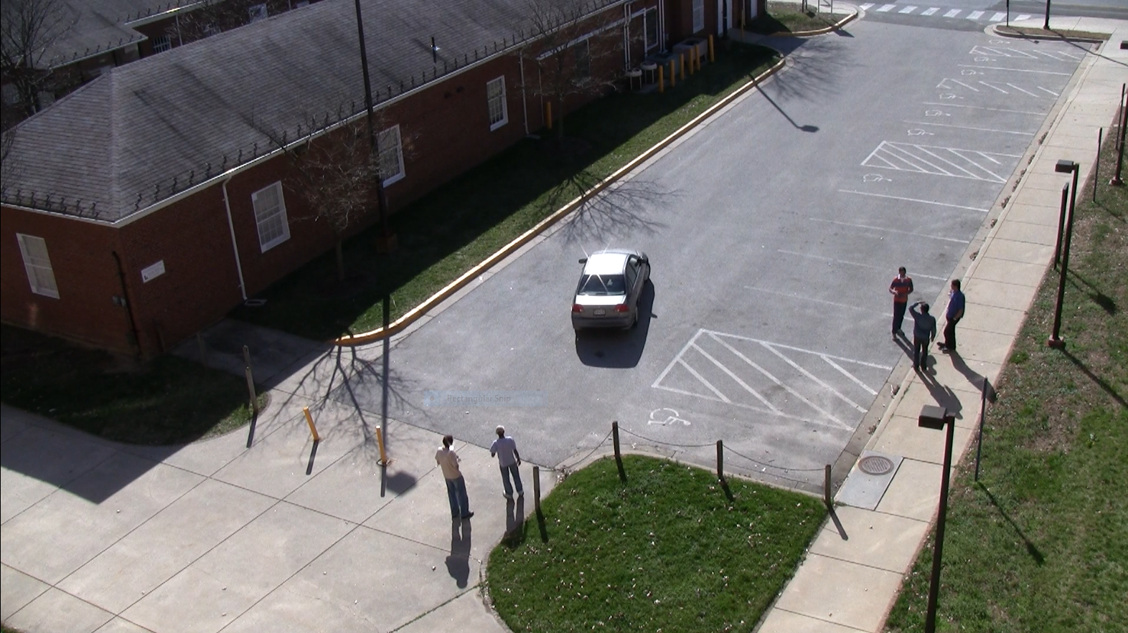
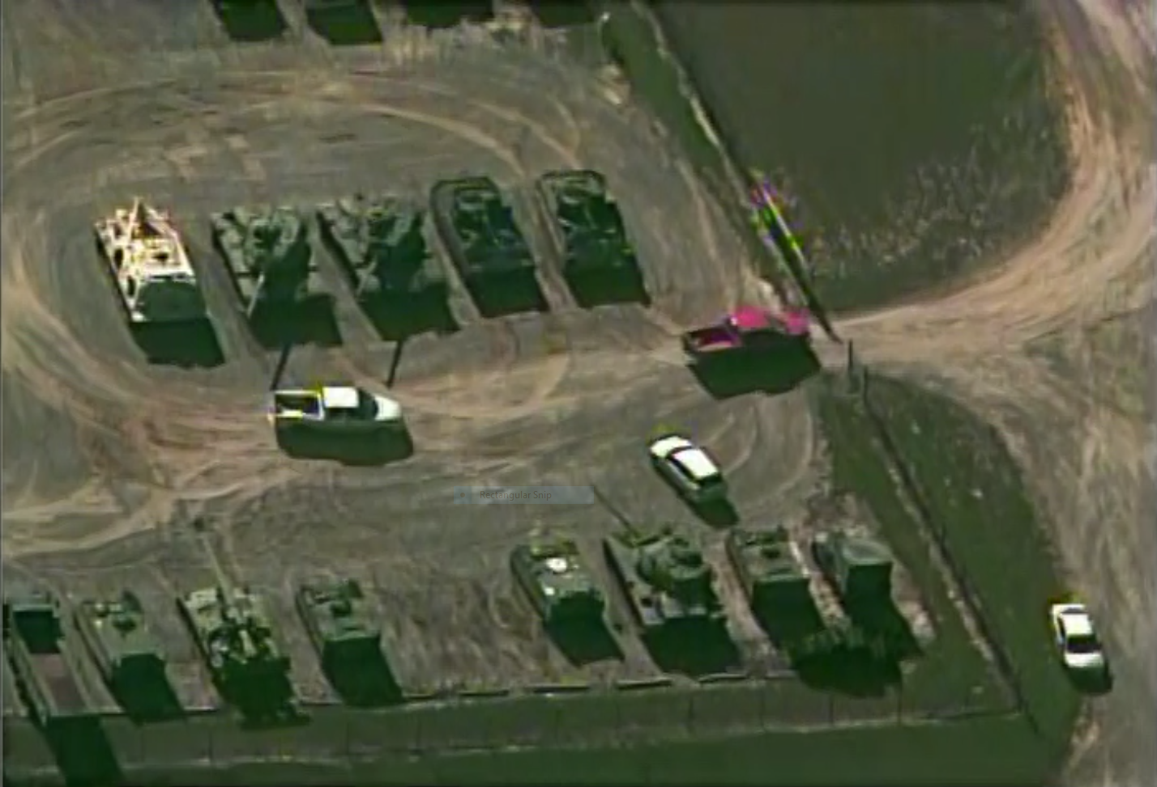
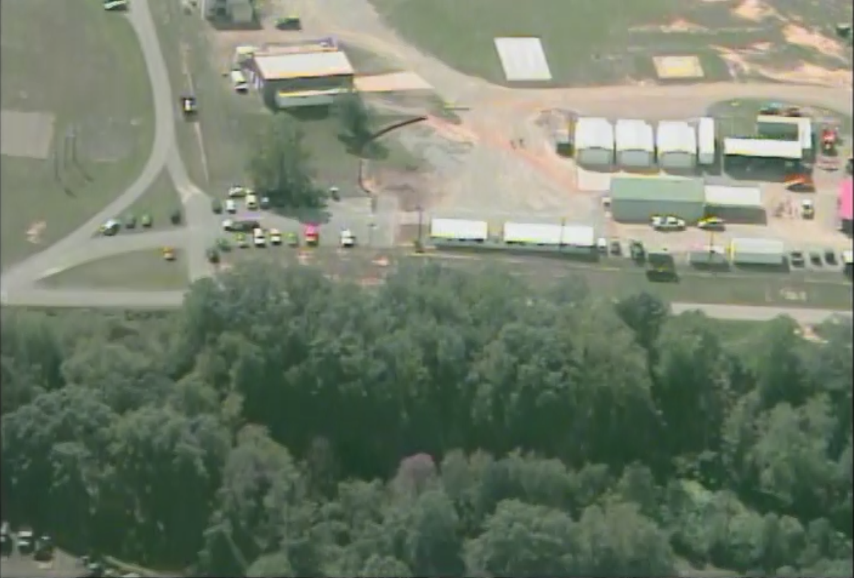
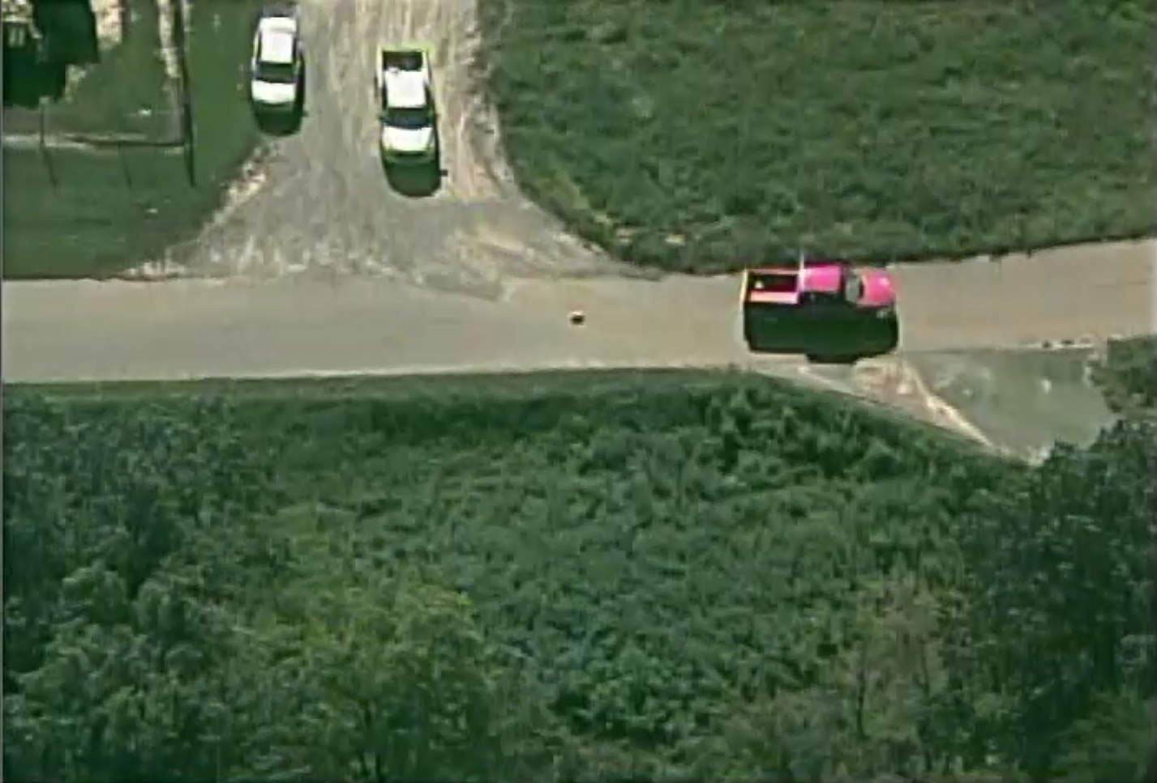
VIRAT Dataset
Ground Data
Aerial Data
Notes:
MUHSIN

Slide 7
Experiments
4x, 8x, 16x Downscaling
Random Cropped Patch
Whole Image
YOLOv3
Notes:
MUHSIN + KSHITIZ

Slide 8
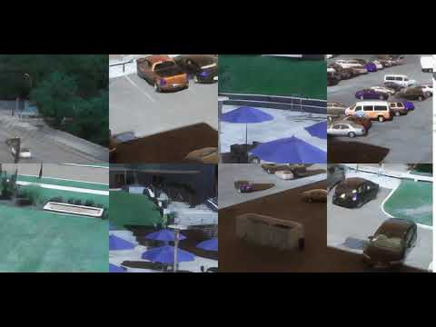
Training GIF
Notes:
KSHITIZ

Slide 9
Results
Notes:
KSHITIZ

Slide 10
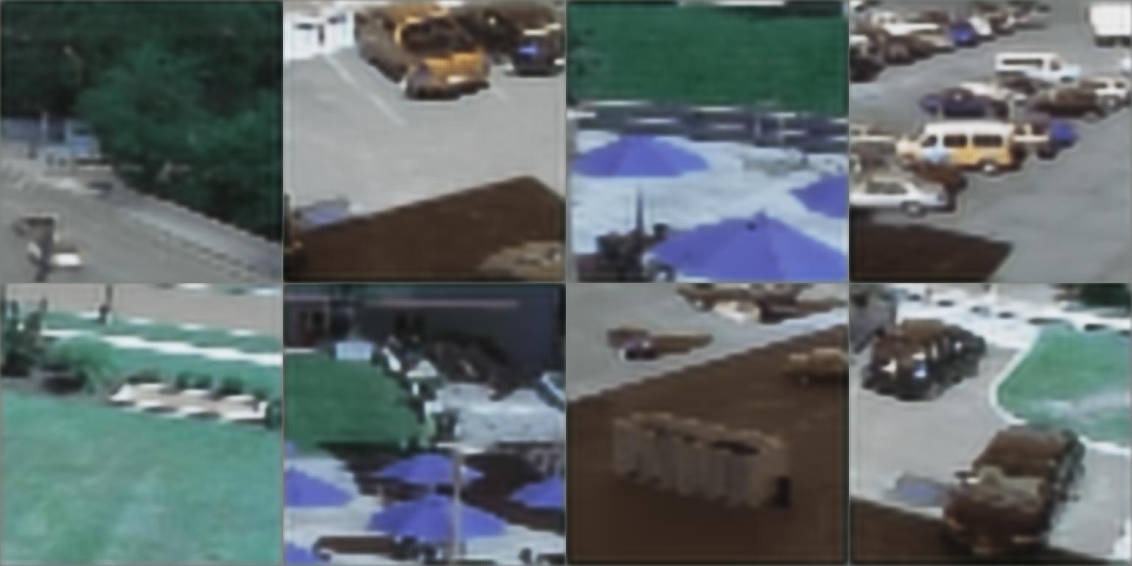
Inputs
Notes:
KSHITIZ

Slide 11
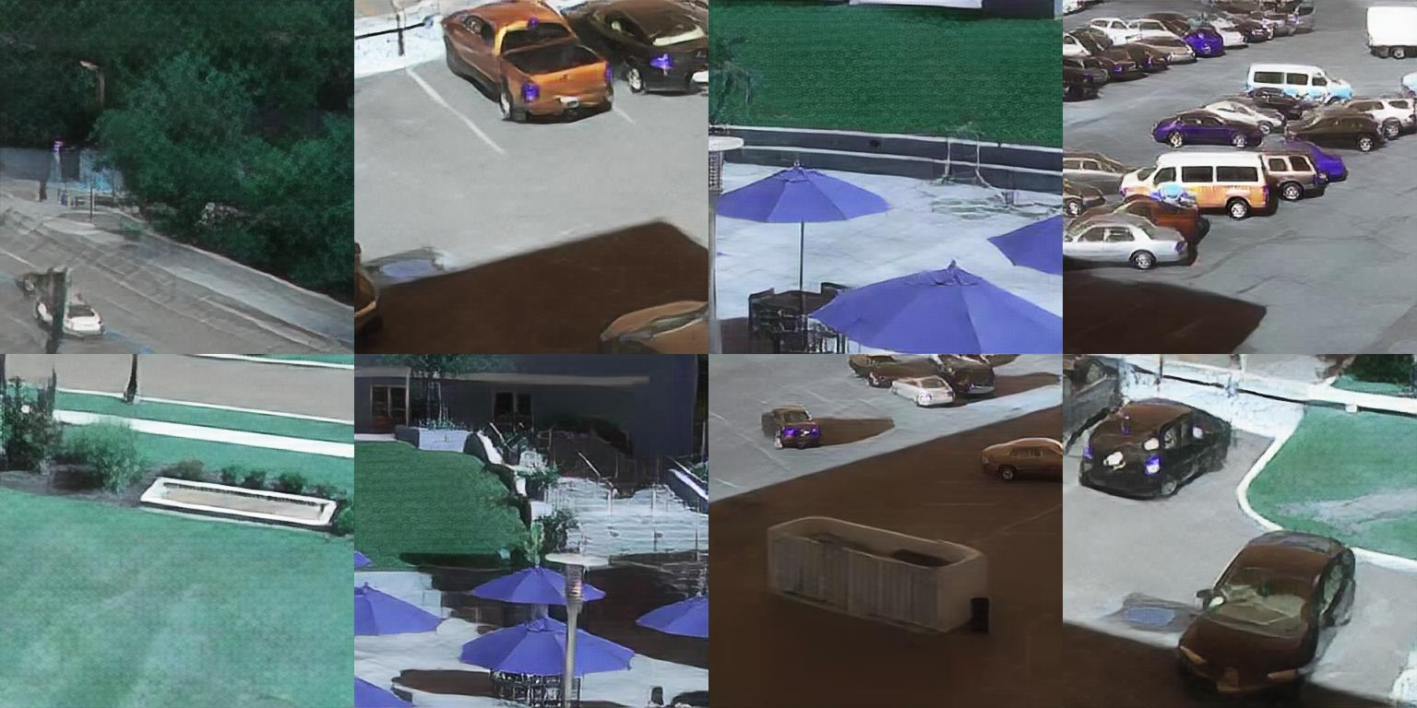
Outputs
Notes:
KSHITIZ

Slide 12
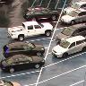


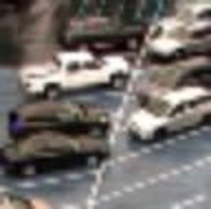

Ground Test Data
 | Bilinear Interpolation | SR-GAN | Ground Truth (HR)
4x
8x
Notes:
KSHITIZ

Slide 13

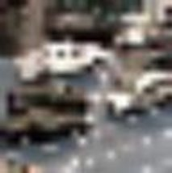
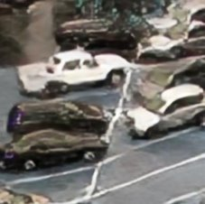
 | Bilinear Interpolation | SR-GAN | Ground Truth (HR)
8x
16x
Notes:
KSHITIZ

Slide 14
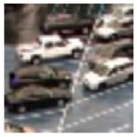
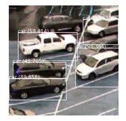
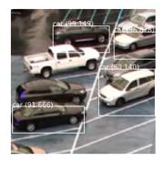
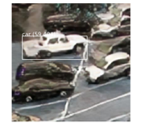
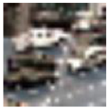
Evaluation – YOLOv3
 | Bilinear Interpolation | SR-GAN | Ground Truth (HR)
8x
16x
Notes:
KSHITIZ

Slide 15
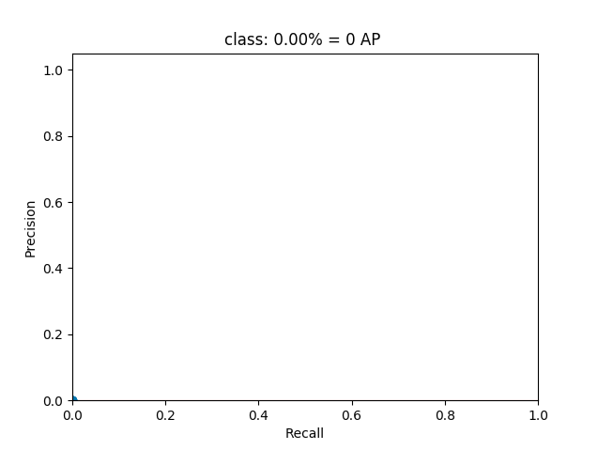
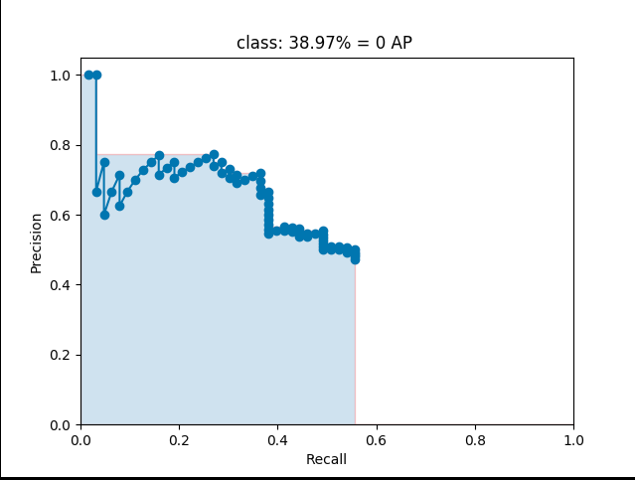
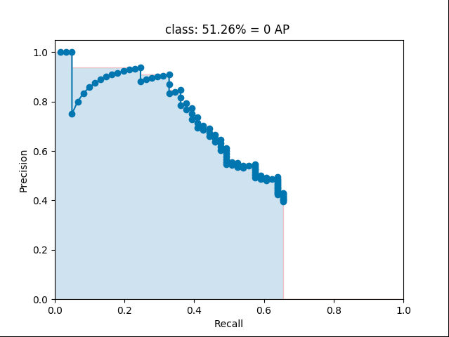
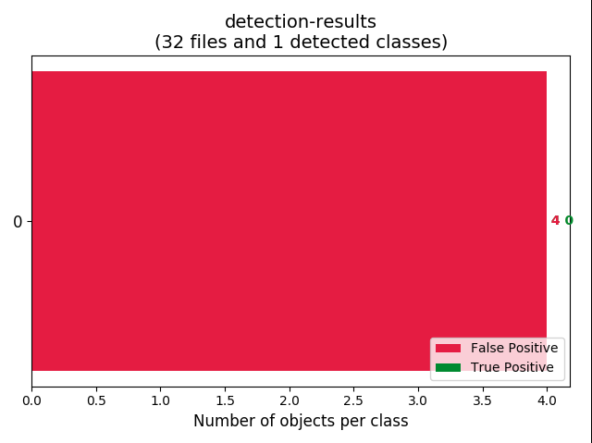
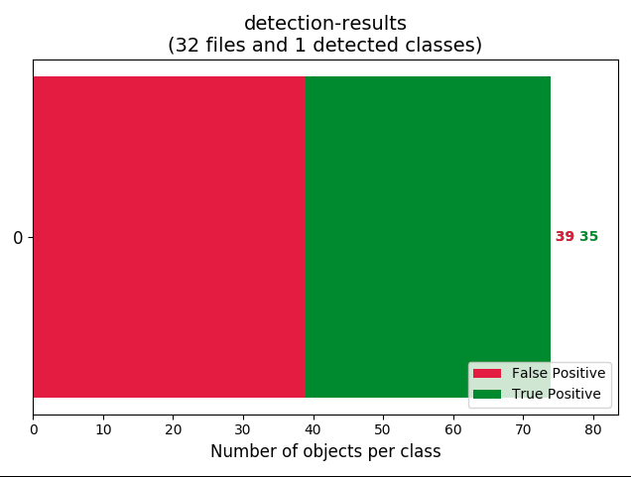
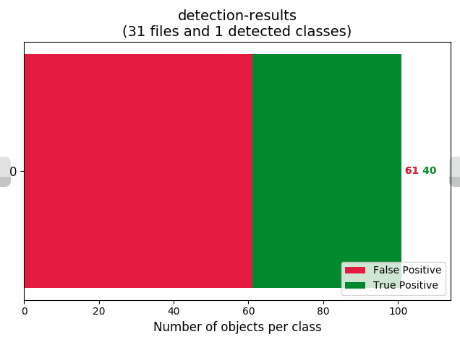
Yolov3 Results (Cars) - 8X Downscaling
Bicubic Interpolation
SR-GAN
Ground Truth (HR)
Notes:
KSHITIZ

Slide 16
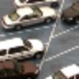
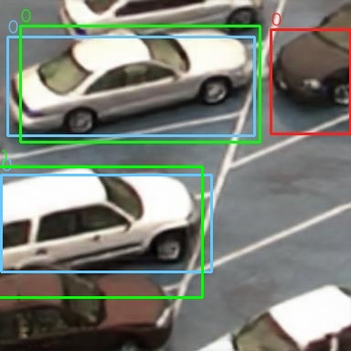
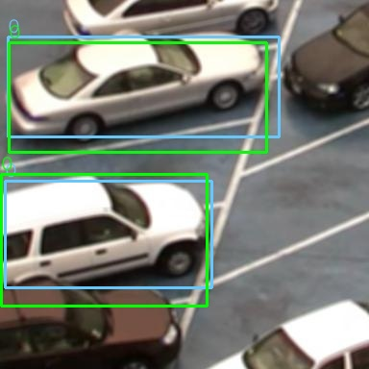
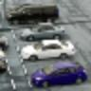
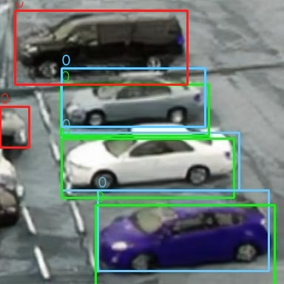
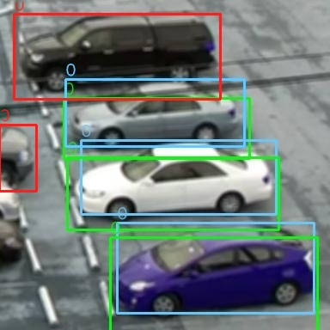
Bicubic Interpolation
SR-GAN
High Resolution
Notes:
KSHITIZ

Slide 17
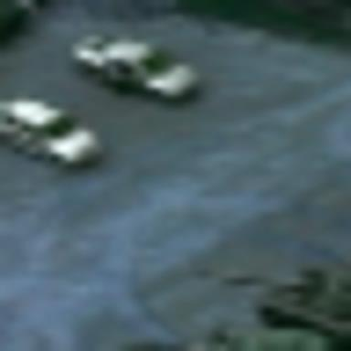
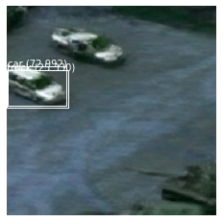
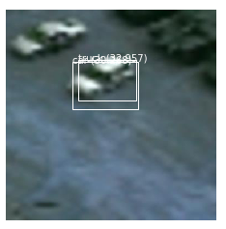
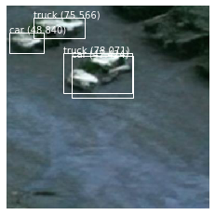
Aerial Test Data
Bicubic Interpolation
SR-GAN
No high resolution images
No bounding Box Labels
Notes:
MUHSIN

Slide 18
Thank You
Notes:
KSHITIZ

Slide 19
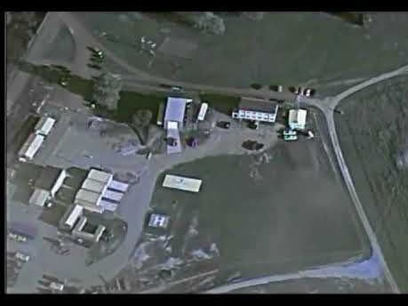
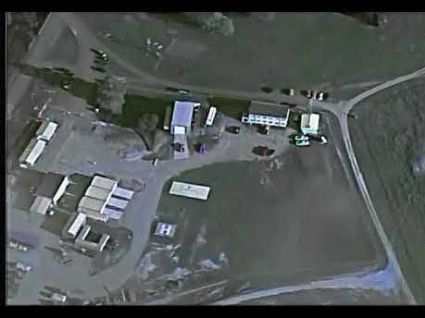
Notes:
MUHSIN

